Slide 1

Presented By : Yash Goel Id : IP180063 Enroll No : 35627202718 Topic : College Management System

Slide 2

College Management System using JAVA

Slide 3
PRESENTATION FLOW
1)
INTRODUCTION
2)
OBJECTIVE
CONCLUSION
3)
5)
4)
SYSTEM REQUIREMENTS
NUMBER OF MODULES
6)
7)
WORKING OF ALL MODULES
FLOWCHART
UML DIAGRAM
8)
ALGORITHM
10)
9)
FUTURE SCOPE

Slide 4

INTRODUCTION
Java is a Evergreen programming language created by James Gosling from Sun Microsystems (Sun) in 1991.
The target of Java is to write a program once and then run this program on multiple operating systems
I Have Used Java Language To Develop My Project.

Slide 5

OBJECTIVES
The main objective of the College Management System is to manage the details of College,Faculty,Course,Batch,Session.
The purpose of this project is to build an application program to reduce the manual work for managing the College, Faculty, Student, Course.
It tracks all the details about the Course,Batch,Session and many more.

Slide 6

TECHNOLOGY USED
OPERATING SYSTEM – WINDOWS/LINUX/IOS
DEVELOPING LANGUAGE – JAVA
PACKAGES USED – AWT , SWING , LANG , SQL etc
DATABASE USED – MYSQL WORKBENCH
OTHER SOFTWARE USED - LAUNCH4J , INNO SETUP

Slide 7
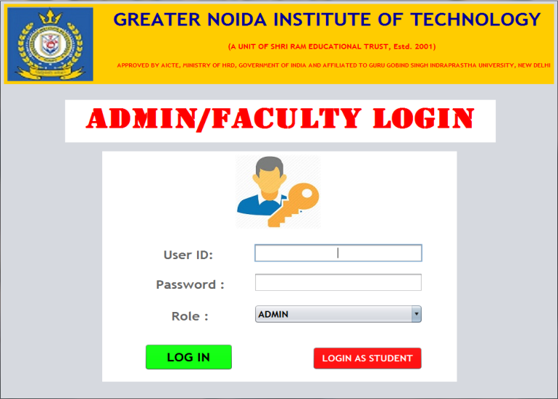
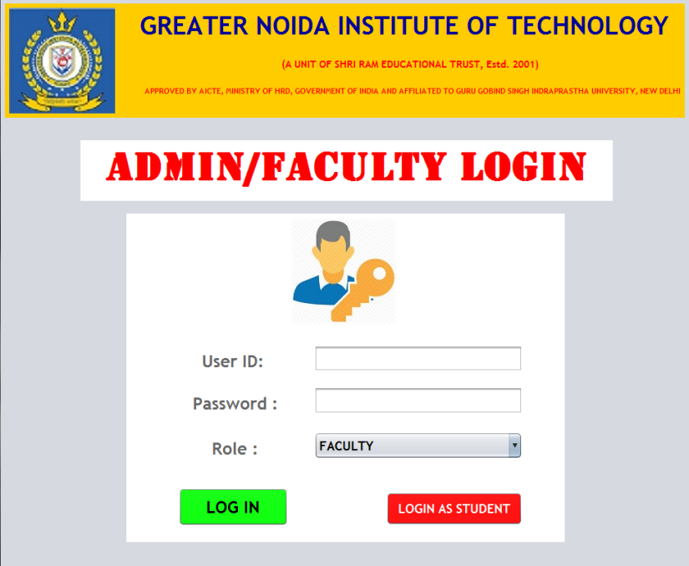
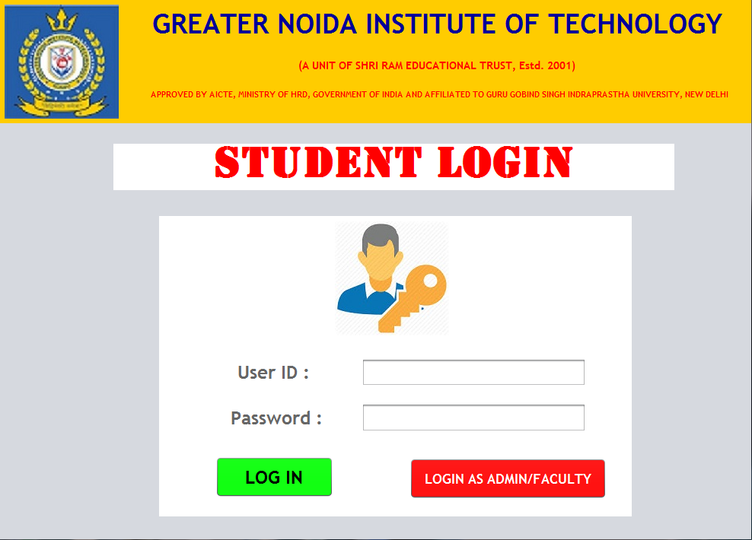
THERE ARE BASICALLY 3 MODULES :
1) ADMIN
2) FACULTY
3) STUDENT

Slide 8
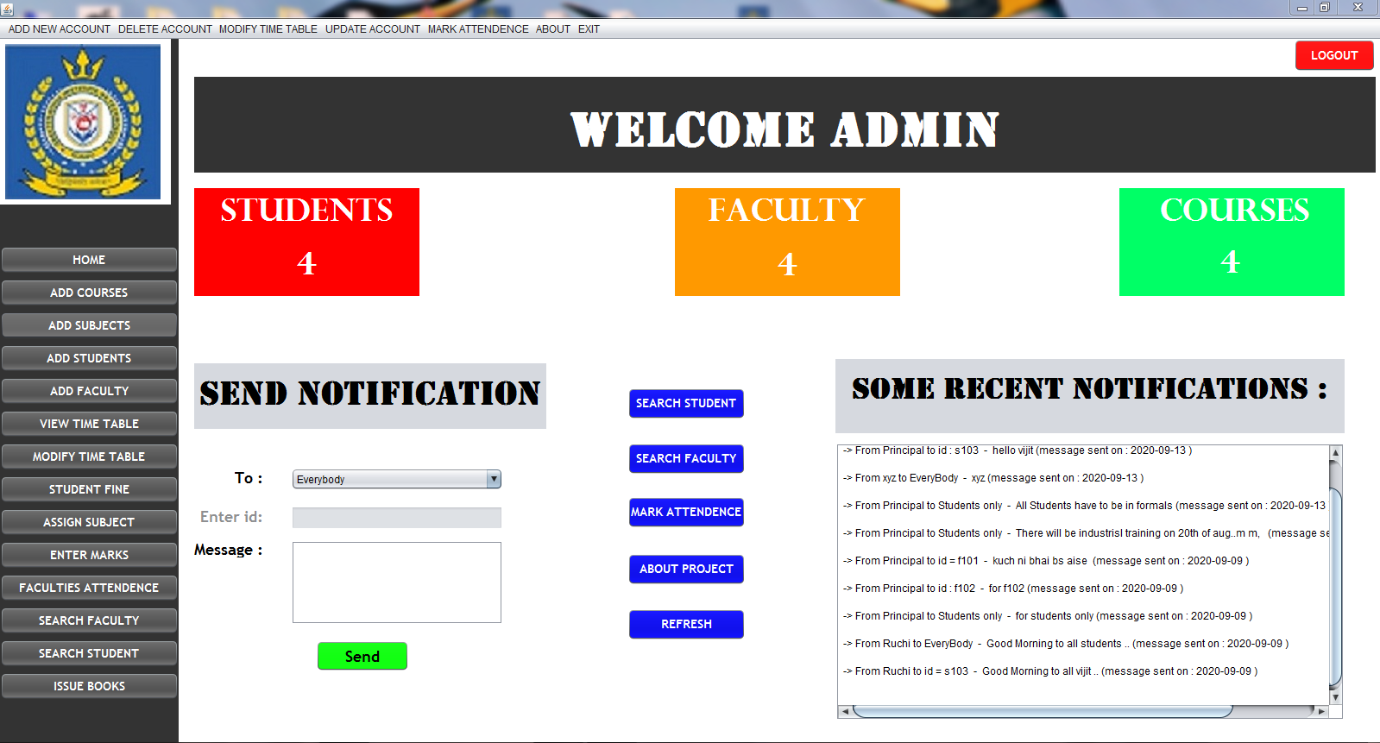
FRONT PAGE OF ADMIN :

Slide 9
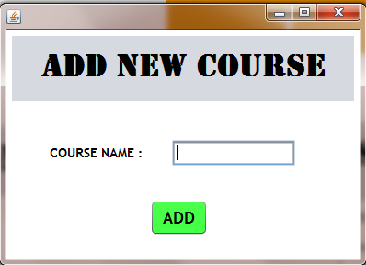
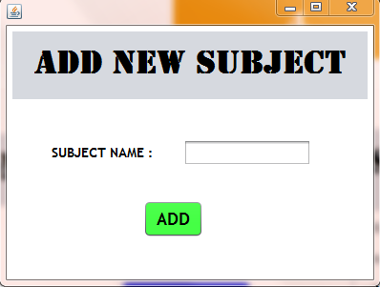
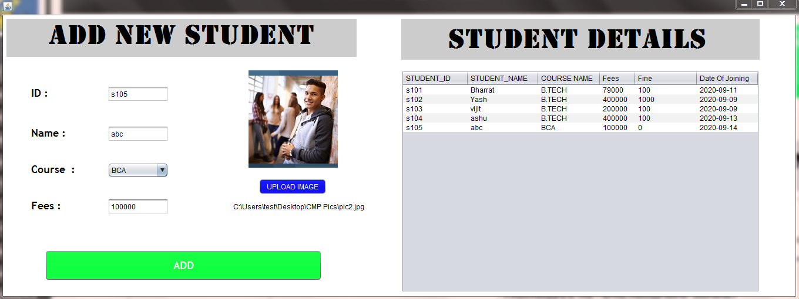
FUNCTIONALITY OF ADMIN MODULE

Slide 10
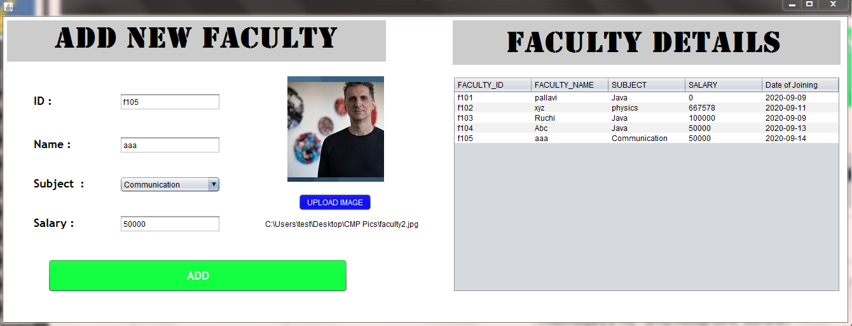
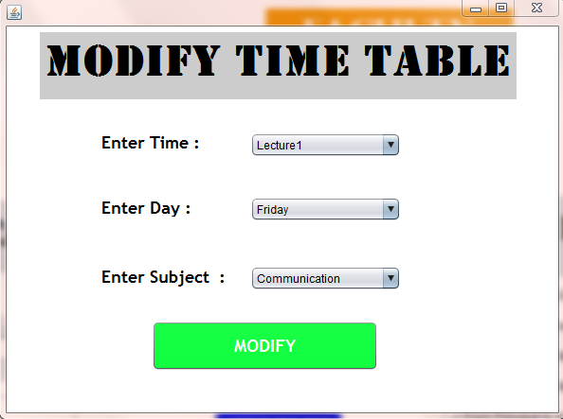
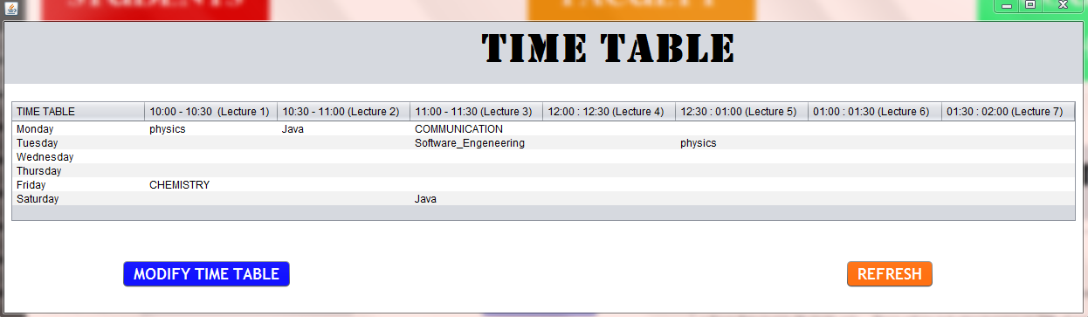

Slide 11
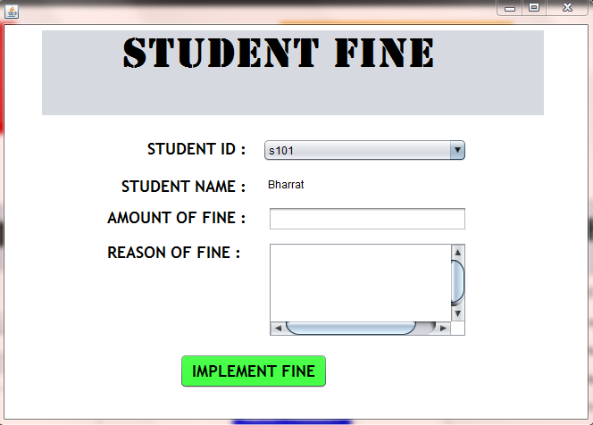
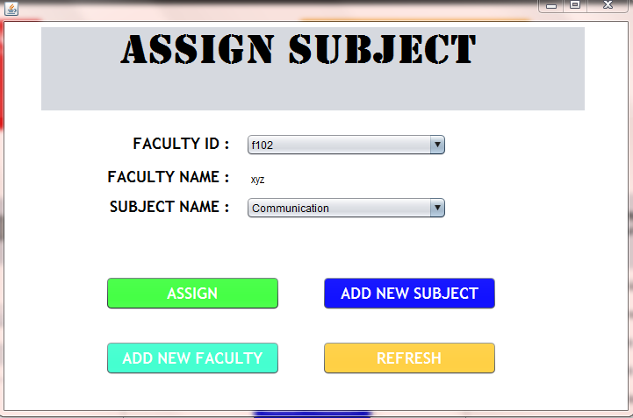
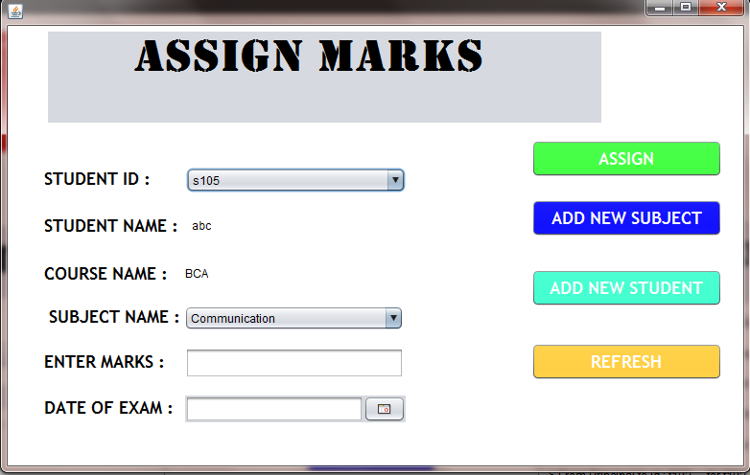
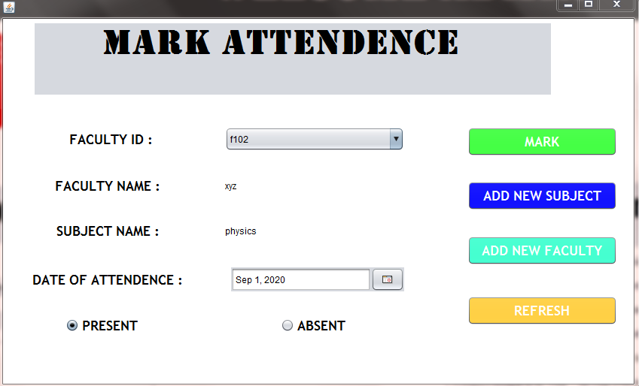

Slide 12
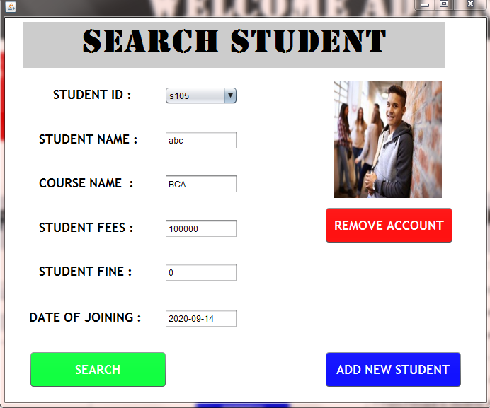
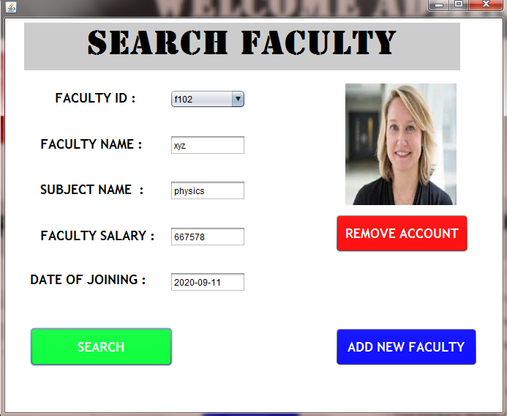
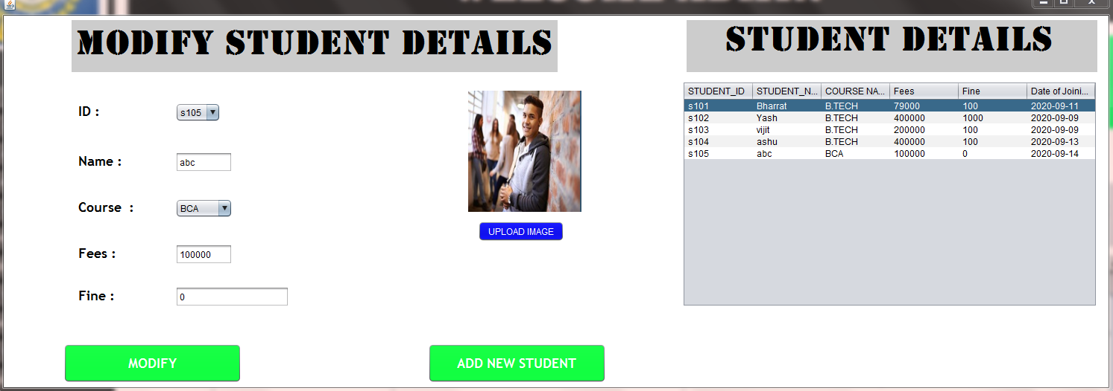

Slide 13
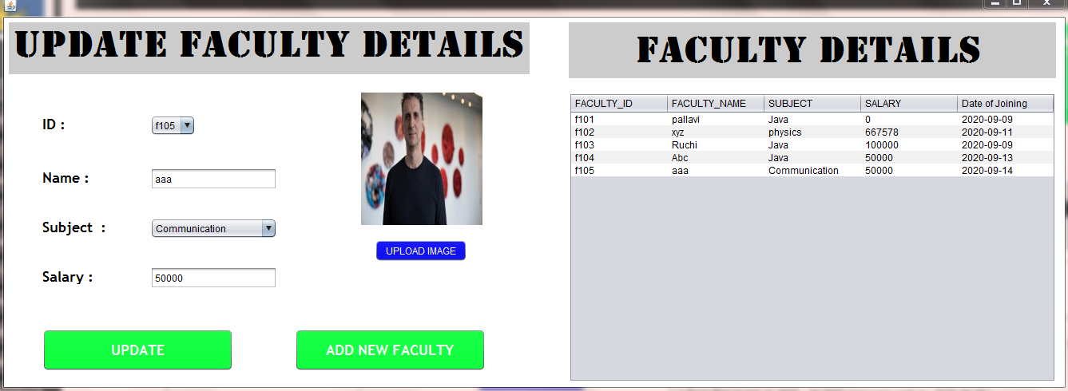
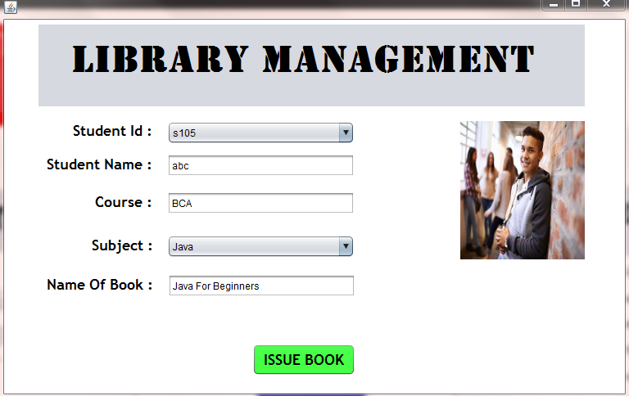
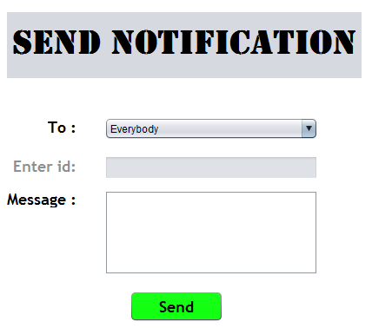

Slide 14
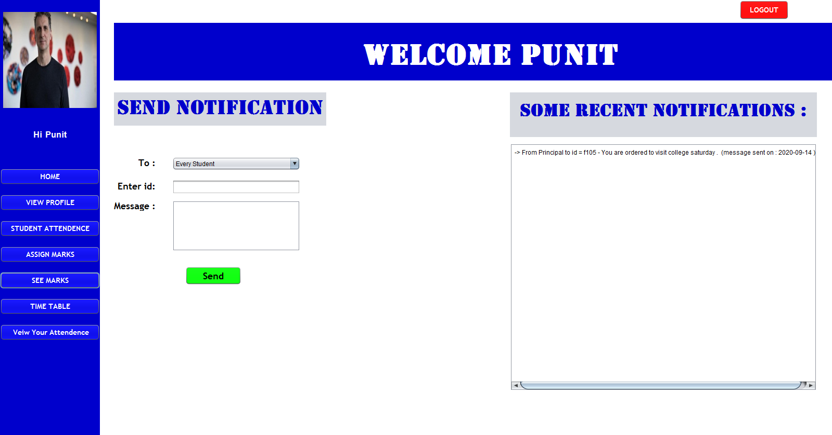
Home Page Of Faculty

Slide 15
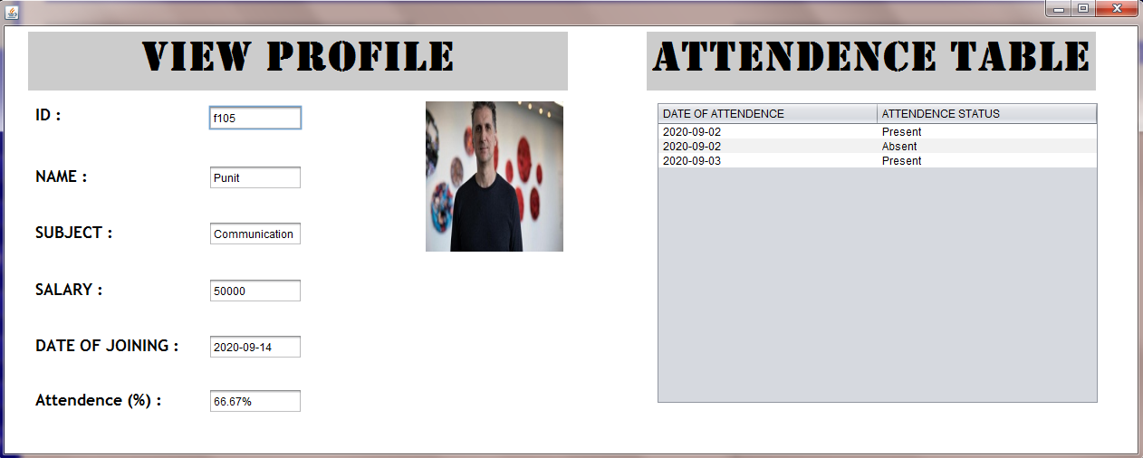
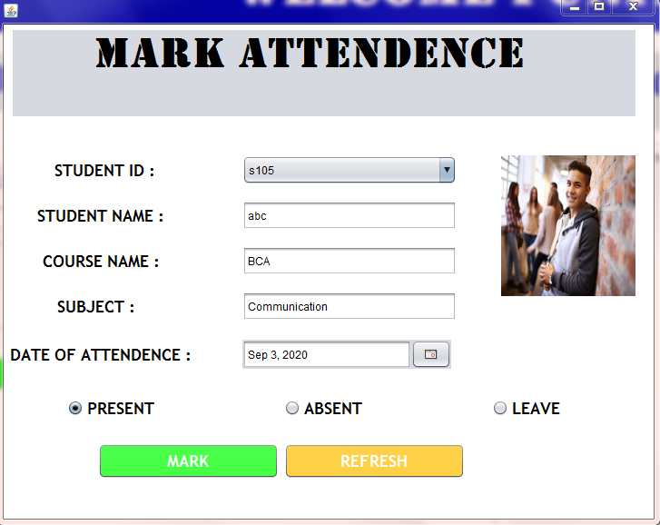
Functionality Of Faculty MODULE

Slide 16
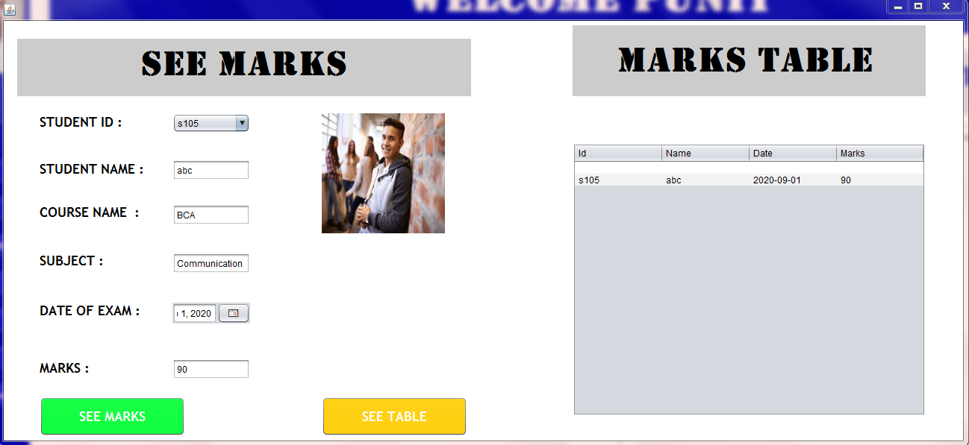

Slide 17
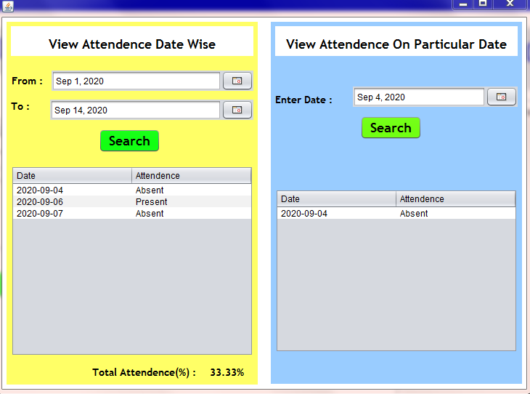
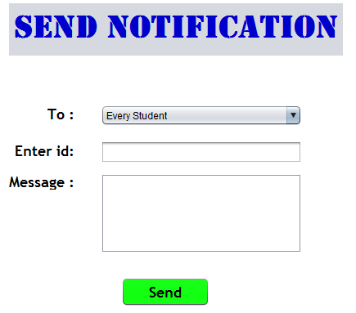

Slide 18
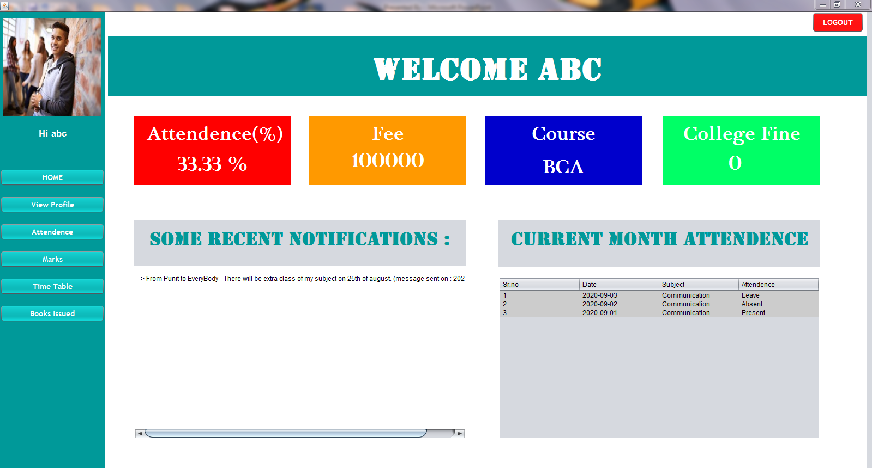
HOME PAGE OF STUDENT

Slide 19
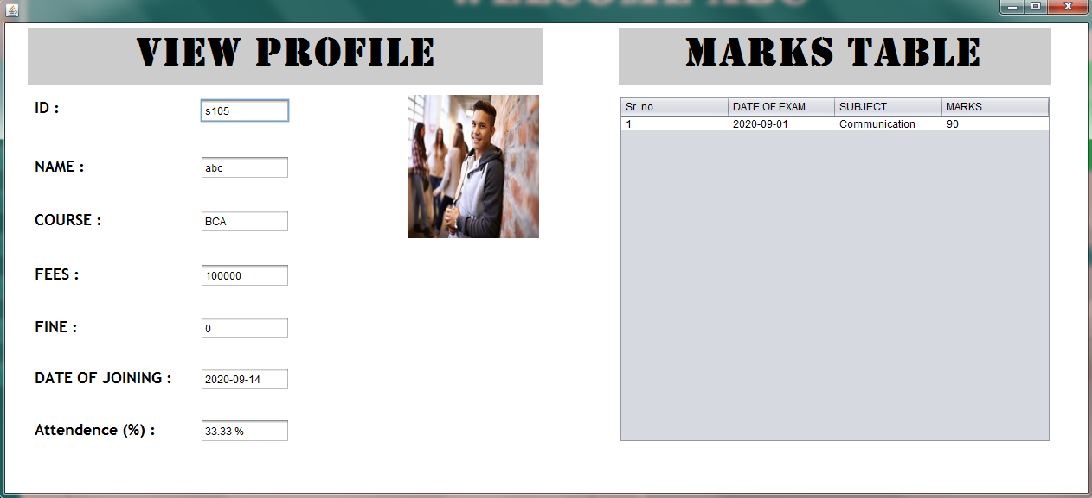
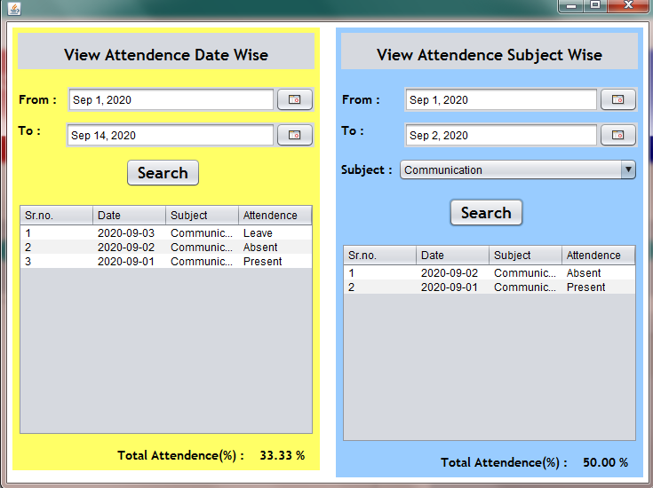
FUNCTIONALITY OF STUDENT MODULE

Slide 20
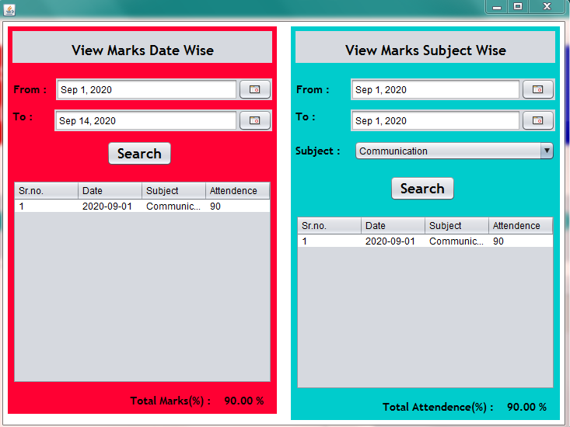

Slide 21
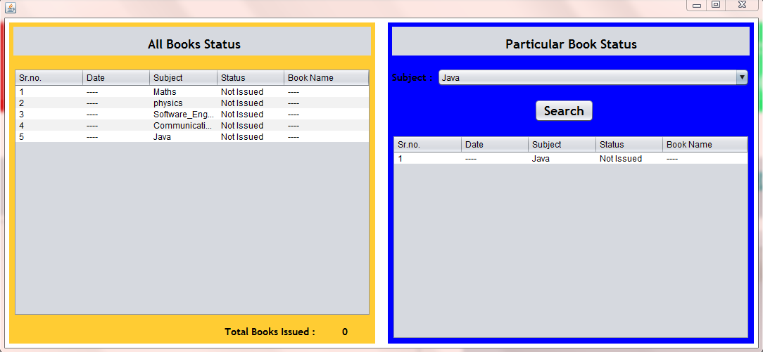

Slide 22
FLOWCHART
START
START
ADMIN/FACULTY LOGIN
STUDENT LOGIN
Yes
IF LOGOUT
Yes
IF LOGOUT
No
No
SEE DATA
ADD DATA
STOP

Slide 23
UML DIAGRAM
Add Student
View Profile
View Profile
Add Faculty
Assign Marks
View Marks D.W
Assign Marks
View Atendn..
View Marks S.W
Faculty Atnde…
Mark Atndnce..
View Attn. D.W
ADMIN
Update Student
FACULTY
See Time Table
STUDENT
View Attn. S.W
Update Faculty
See Marks
View Issued Books
Send Message
Send Message
See Recent Noti
Remove Account
See Recent Noti..
View College fine

Slide 24
ALGORITHM
1) START
2) WHILE(Admin/Faculty Login)
IF LOGIN AS STUDENT
See Data
Logout
ELSE
ENTER DATA
Logout
3) STOP

Slide 25

FUTURE SCOPE
This project deals with the various functioning in College management process. The main idea is to implement a proper process to system . In our existing system contains many operations such as registration, student search, fees, attendance, exam records, performance of the student etc.

Slide 26
CONCLUSION
The Project is designed Keeping in view the day to day problems faced by a college.
In This Project , Messaging System is also added so that all the necessary details (Like Assignment , Notifications ) will be send through this project.
It Reduces the unnecessary wastage of time in personally going to each department for some information.
Awareness and right information about any college is essential for the development of both student and faculty.

Slide 27


